Slide 1
Savvy Coders Class Project December 2023

Slide 2
Main Questions
1. Determine the current state and potential growth of the EV market in the U.S.:
- Is investment in EVs increasing? - How does the US compare to the rest of the world?
2. Identify key areas or regions where EV charging infrastructure is lacking or in high demand: - What State to invest in? Why? - What State to AVOID investing in? Why? - What city to invest in? Why? - What city to AVOID investing in? Why? - Other relevant geographical features

Slide 3
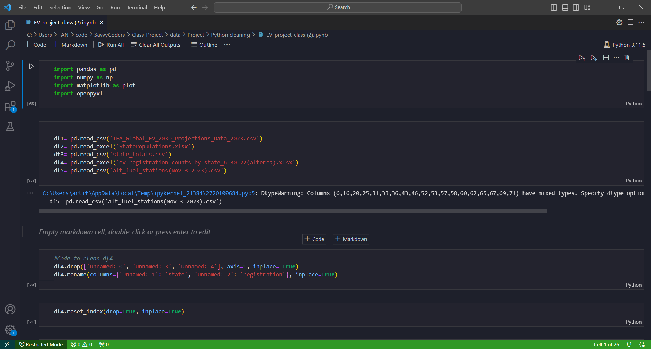
Python Cleaning

Slide 4
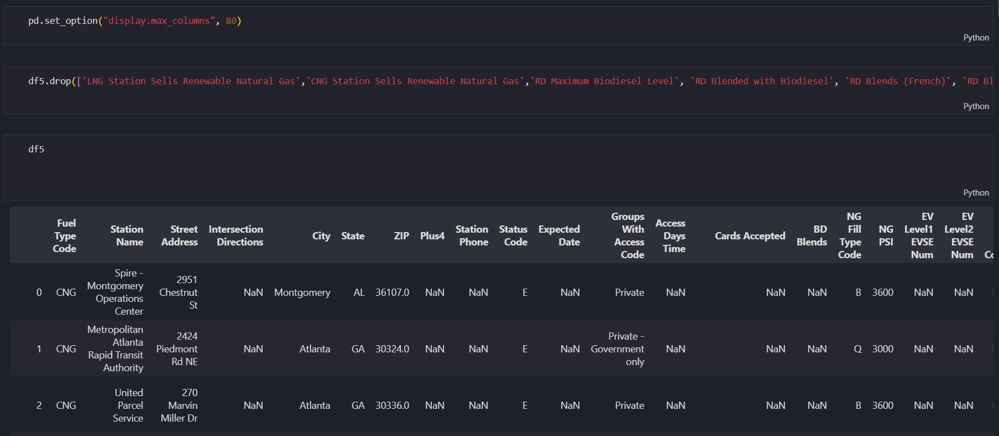
Continuing Python Cleaning

Slide 5
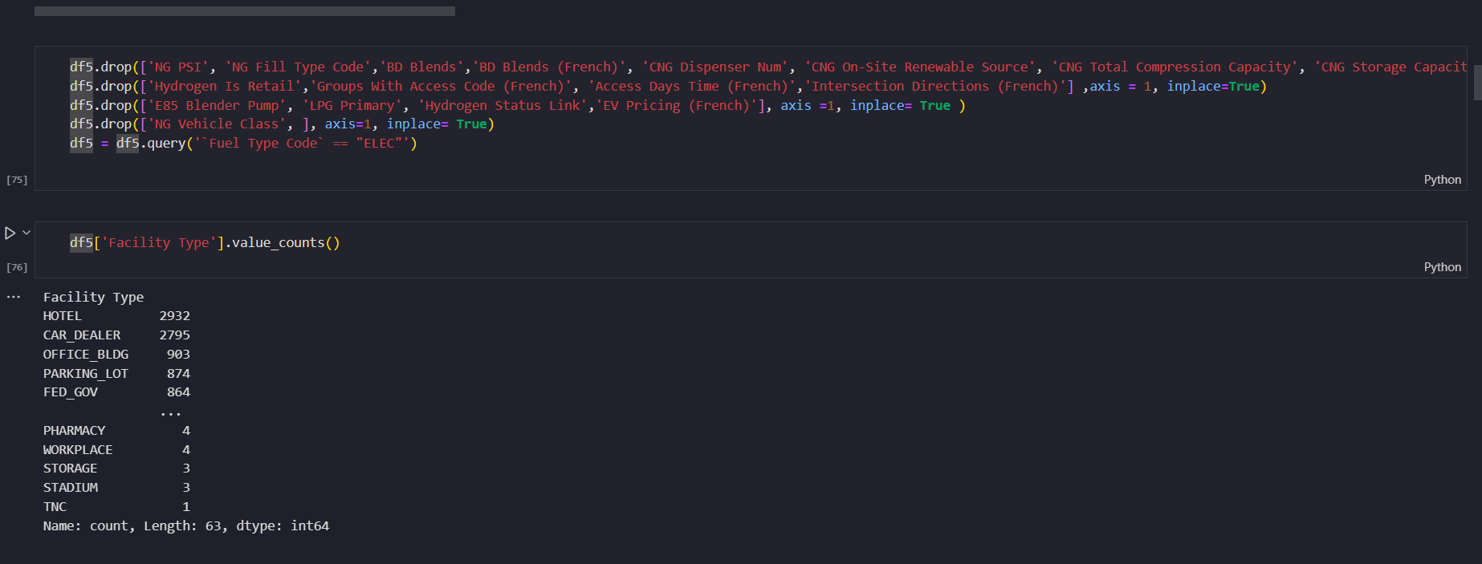
Continuing Python Cleaning

Slide 6
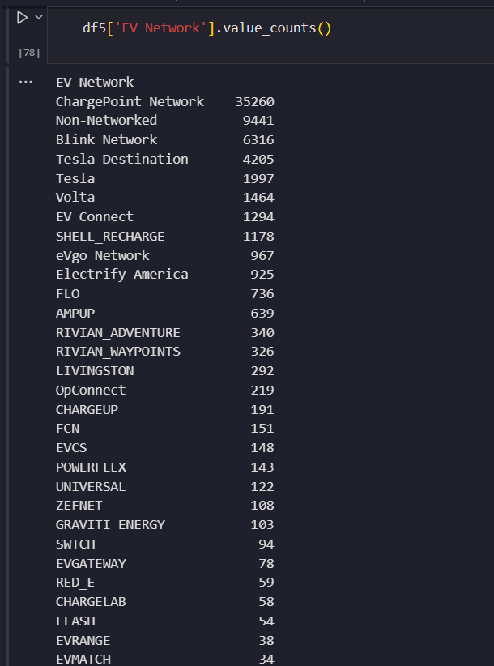
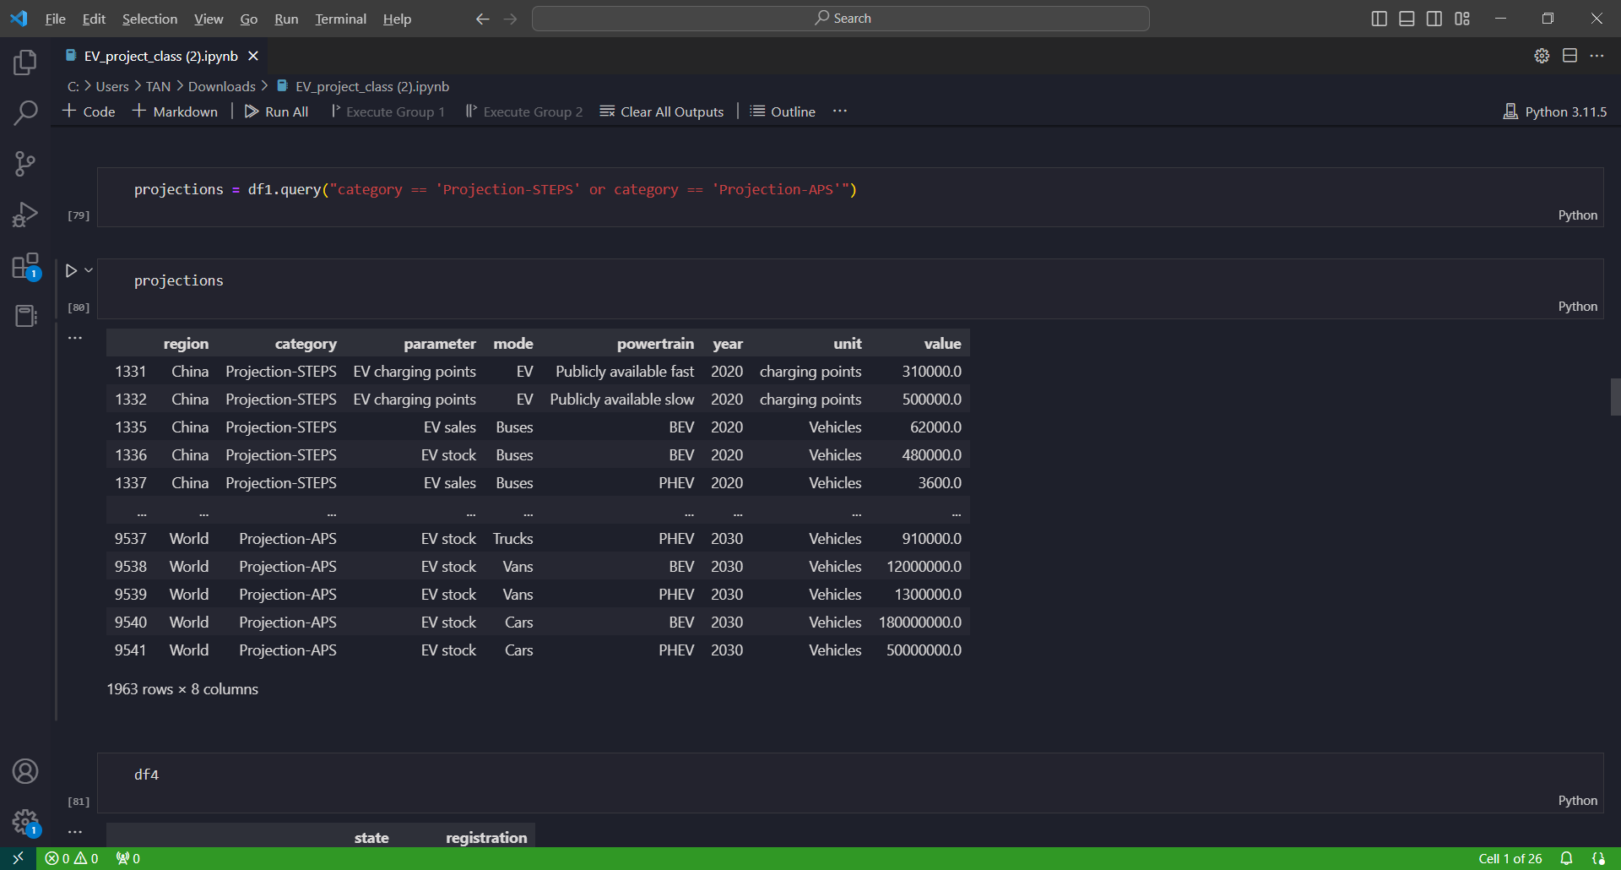
Continuing Python Cleaning

Slide 7
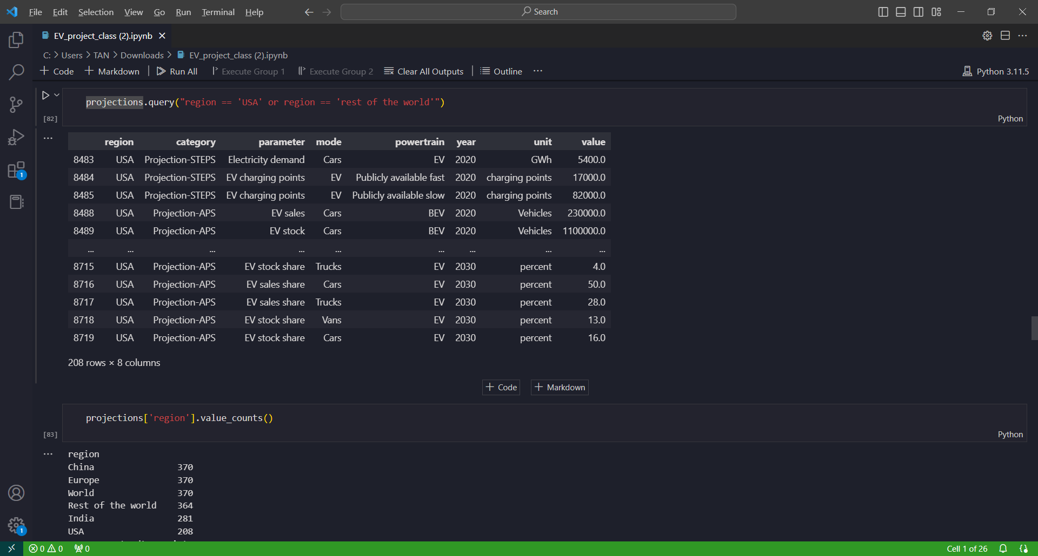
Continuing Python Cleaning

Slide 8
Continuing Python Cleaning

Slide 9
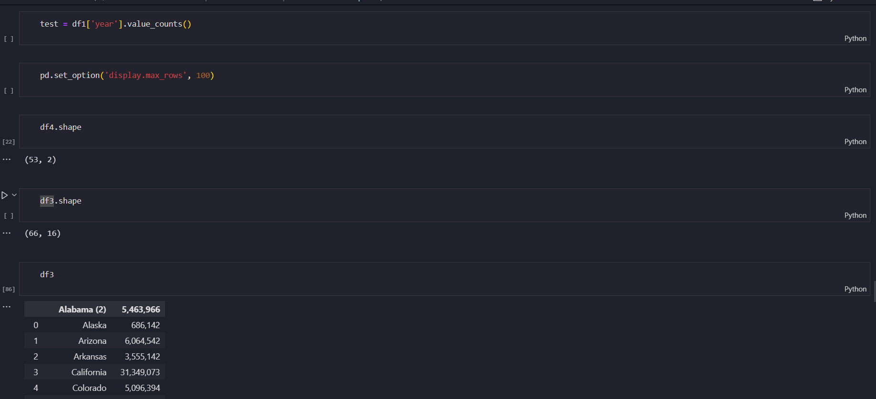
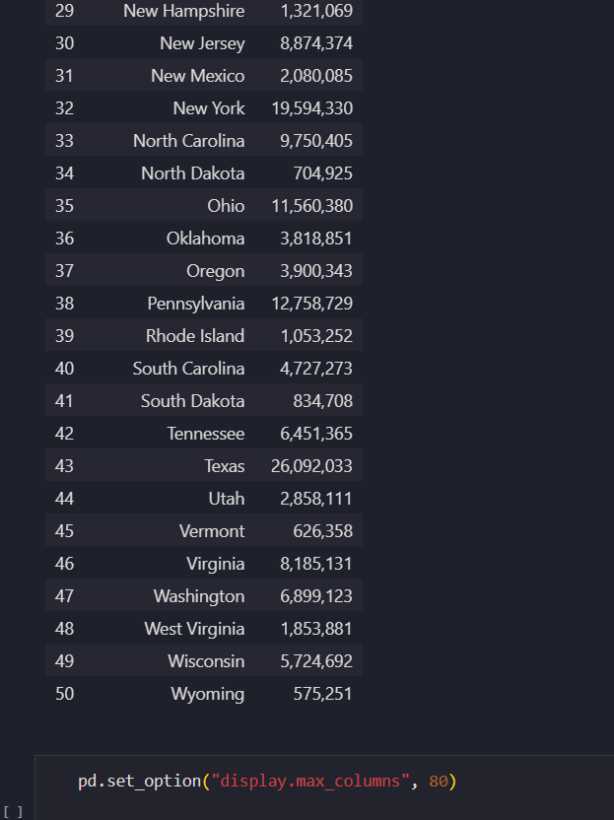
Continuing Python Cleaning

Slide 10
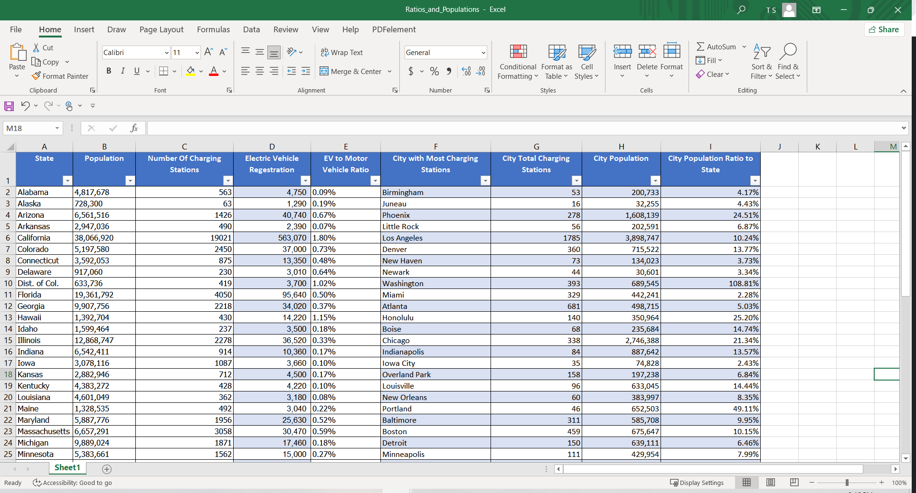
Result Through the SQL Statements

Slide 11
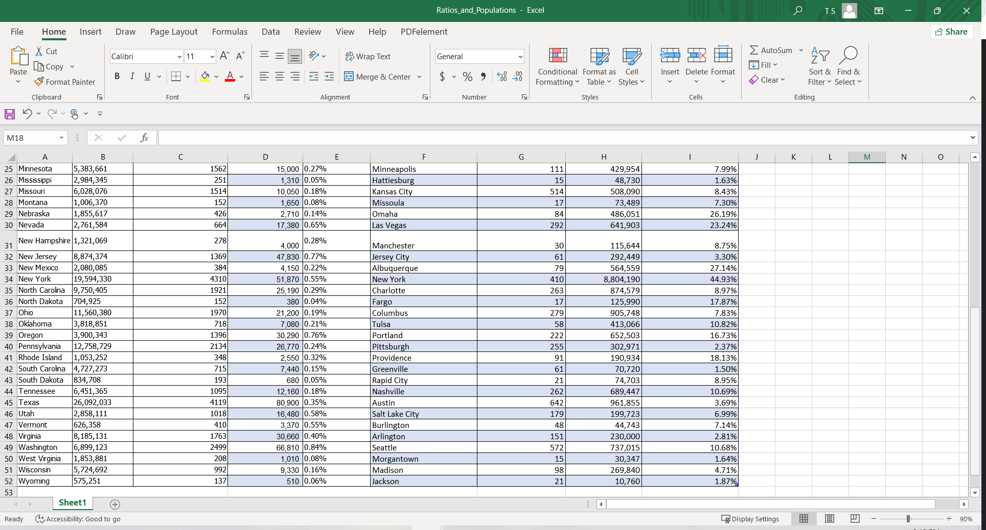
Result Through the SQL Statements

Slide 12
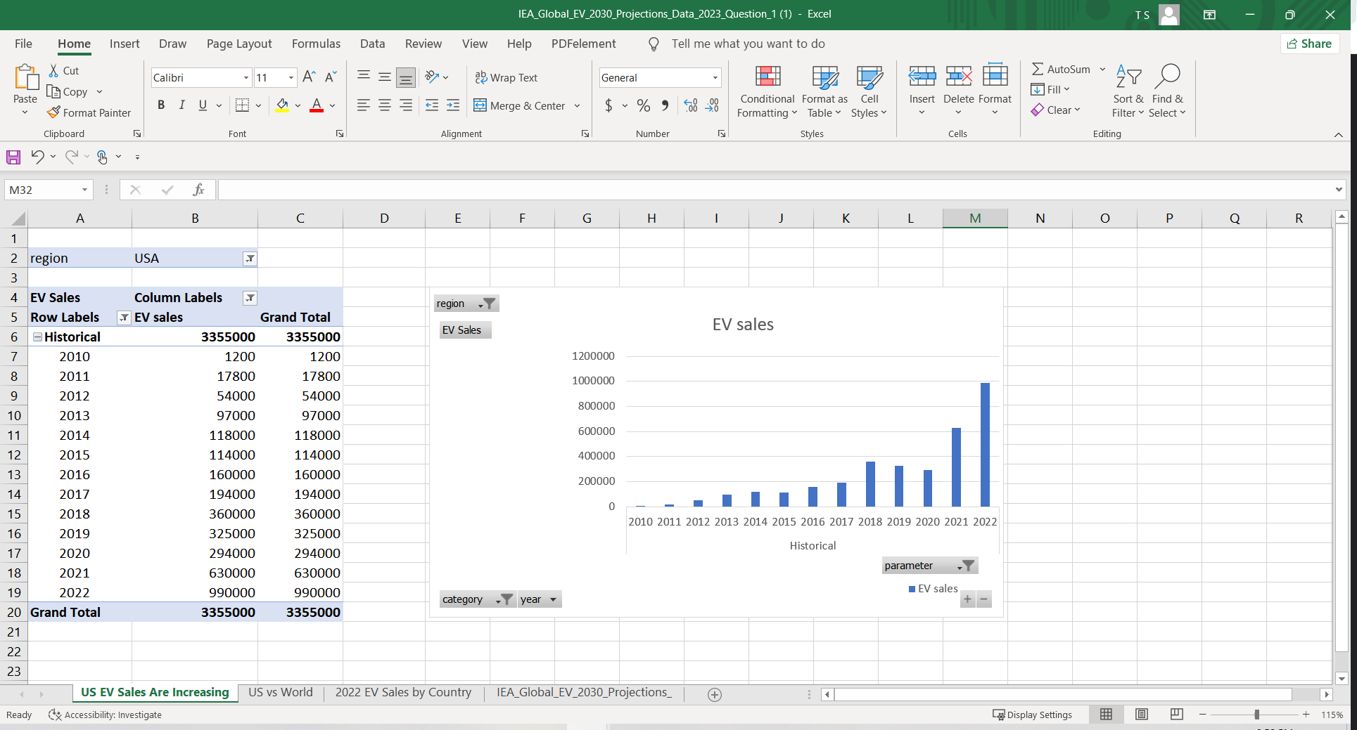
US EV SALEs ARE Increasing

Slide 13
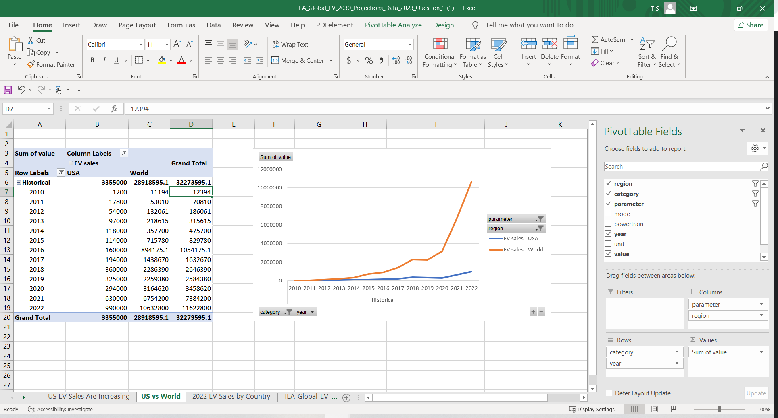
US vs World

Slide 14
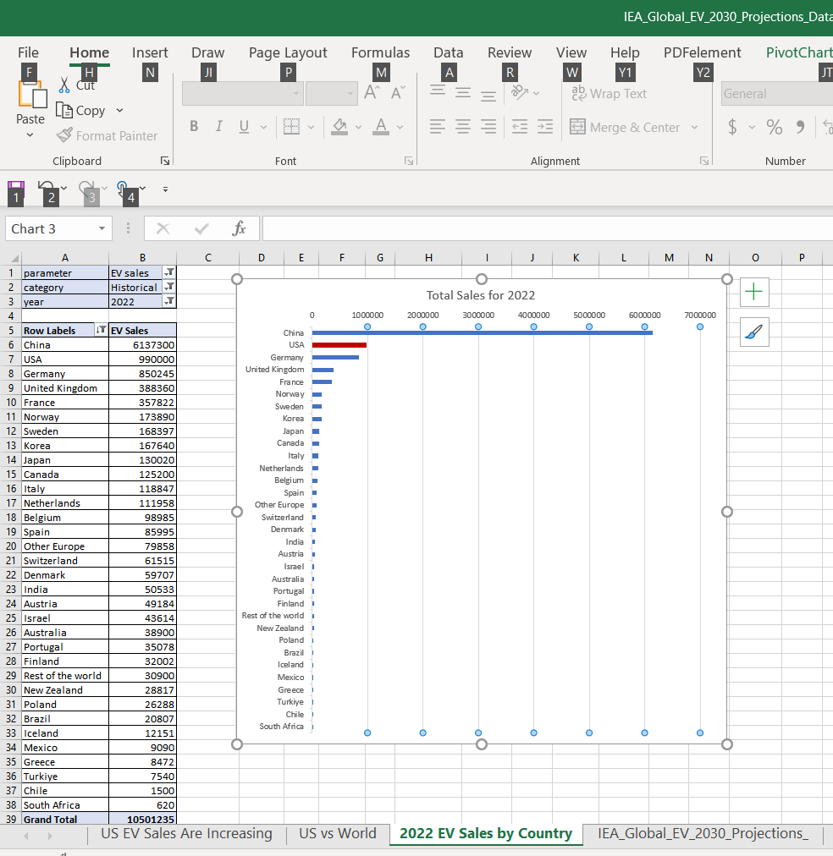
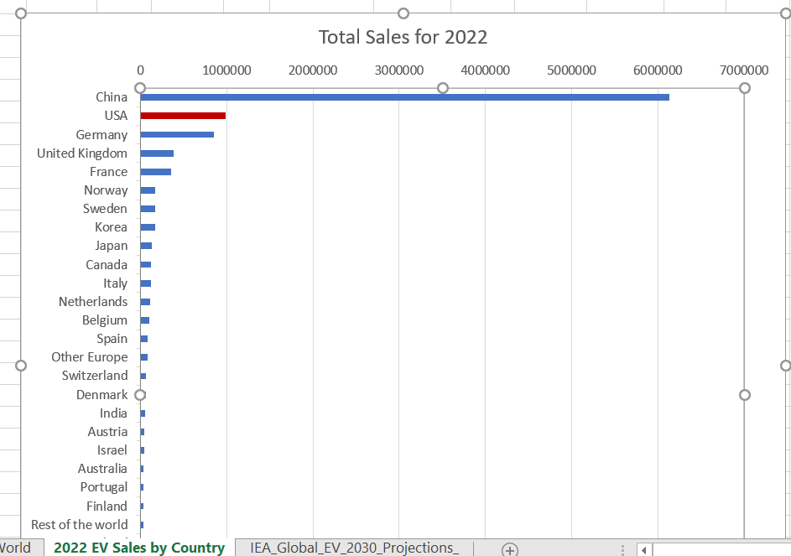
2022 EV sales by country

Slide 15
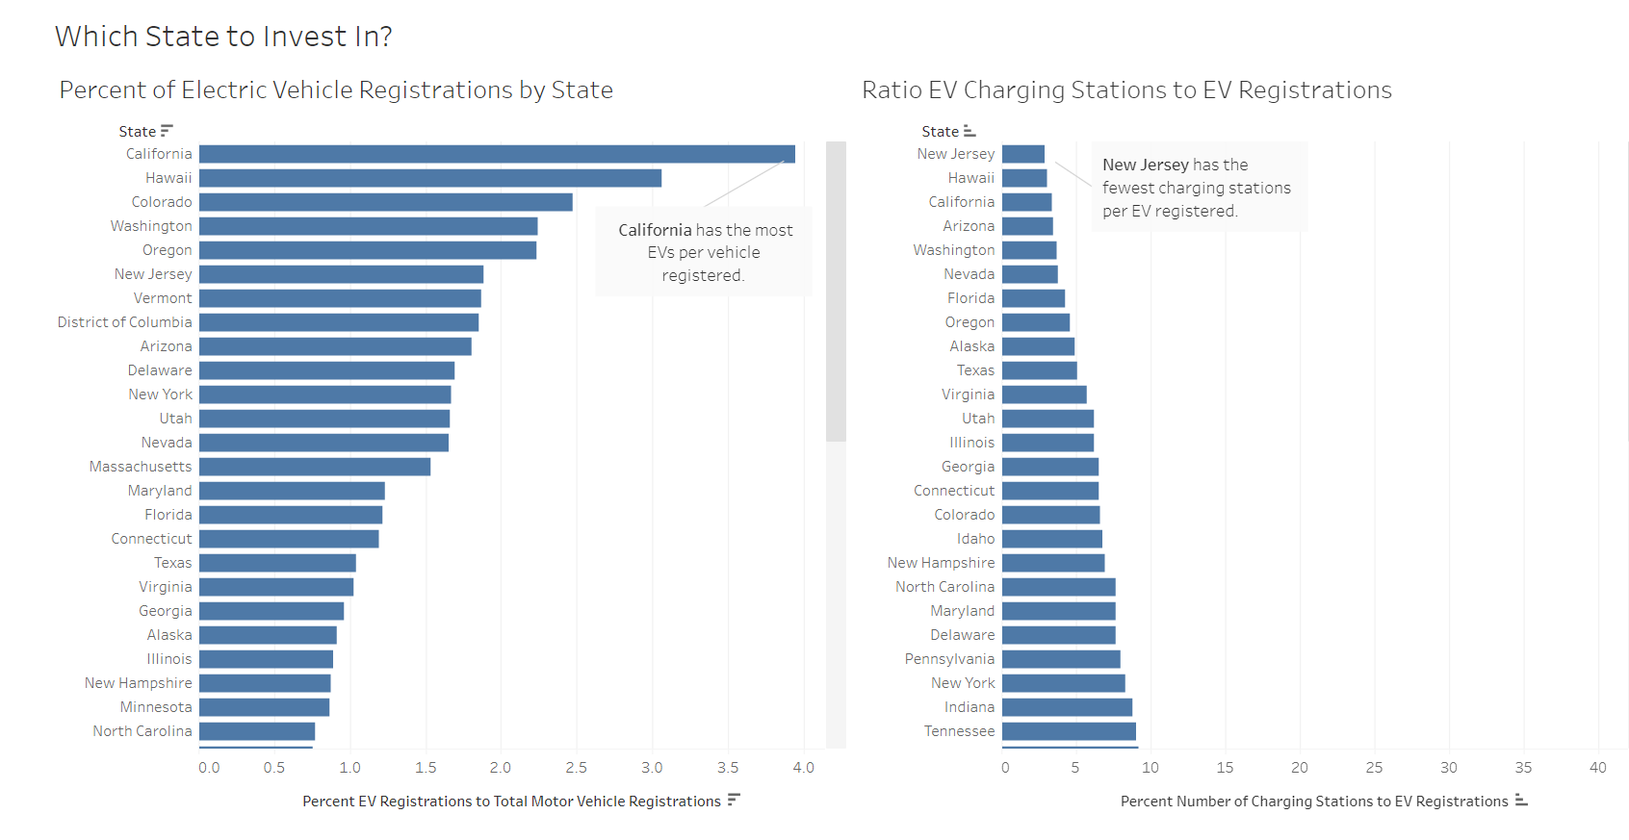
Tableau visualization

Slide 16
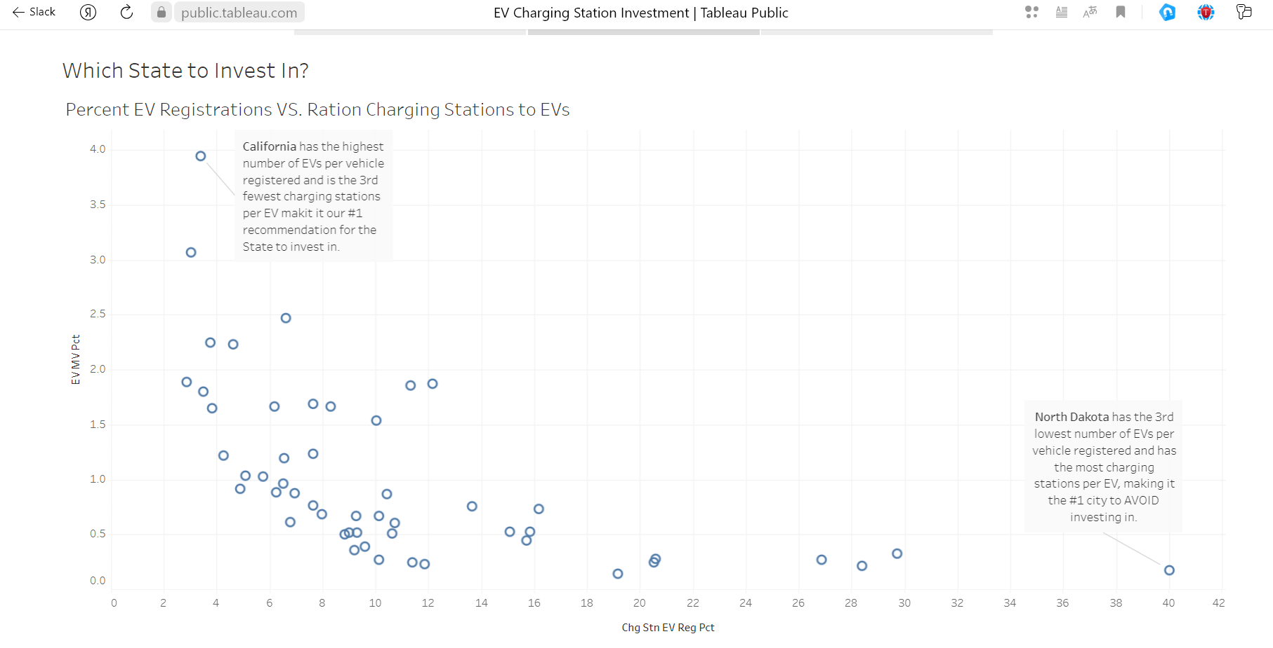

Slide 17
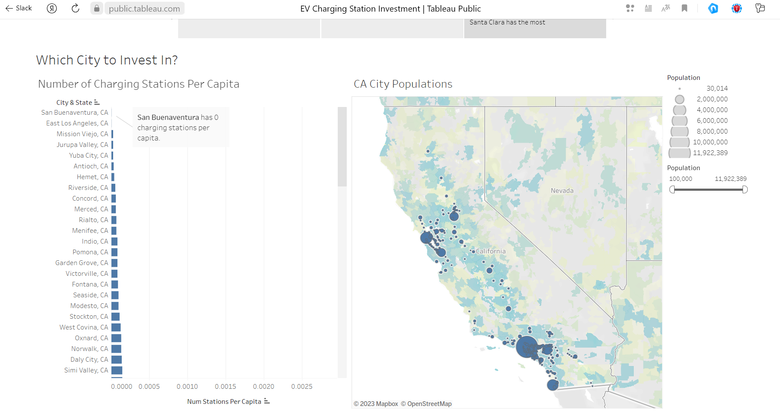

Slide 18
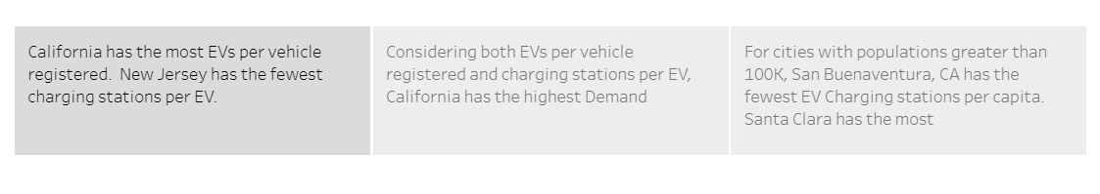
Results

